Slide 1
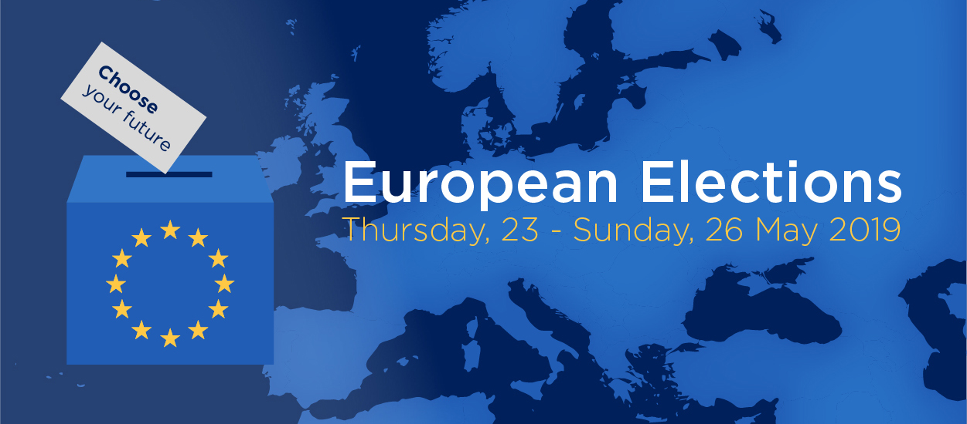
Monday, 27 May 2019
8.30 – 10.00

Slide 2
#EUElections2019

Slide 4
#Elections2019: what impact on the #EU?
Davide Ferrari
Research Executive, VoteWatch Europe

Slide 5
Outcome of EU Elections (current situation)
ALDE -
Renaissance
EAPN
40 seats
15 seats
73 seats
155 seats
108 seats
180 seats
56 seats
73 seats
NI – Left
NI - Centre
NI - Right
2 seats
7 seats
42 seats

Slide 6
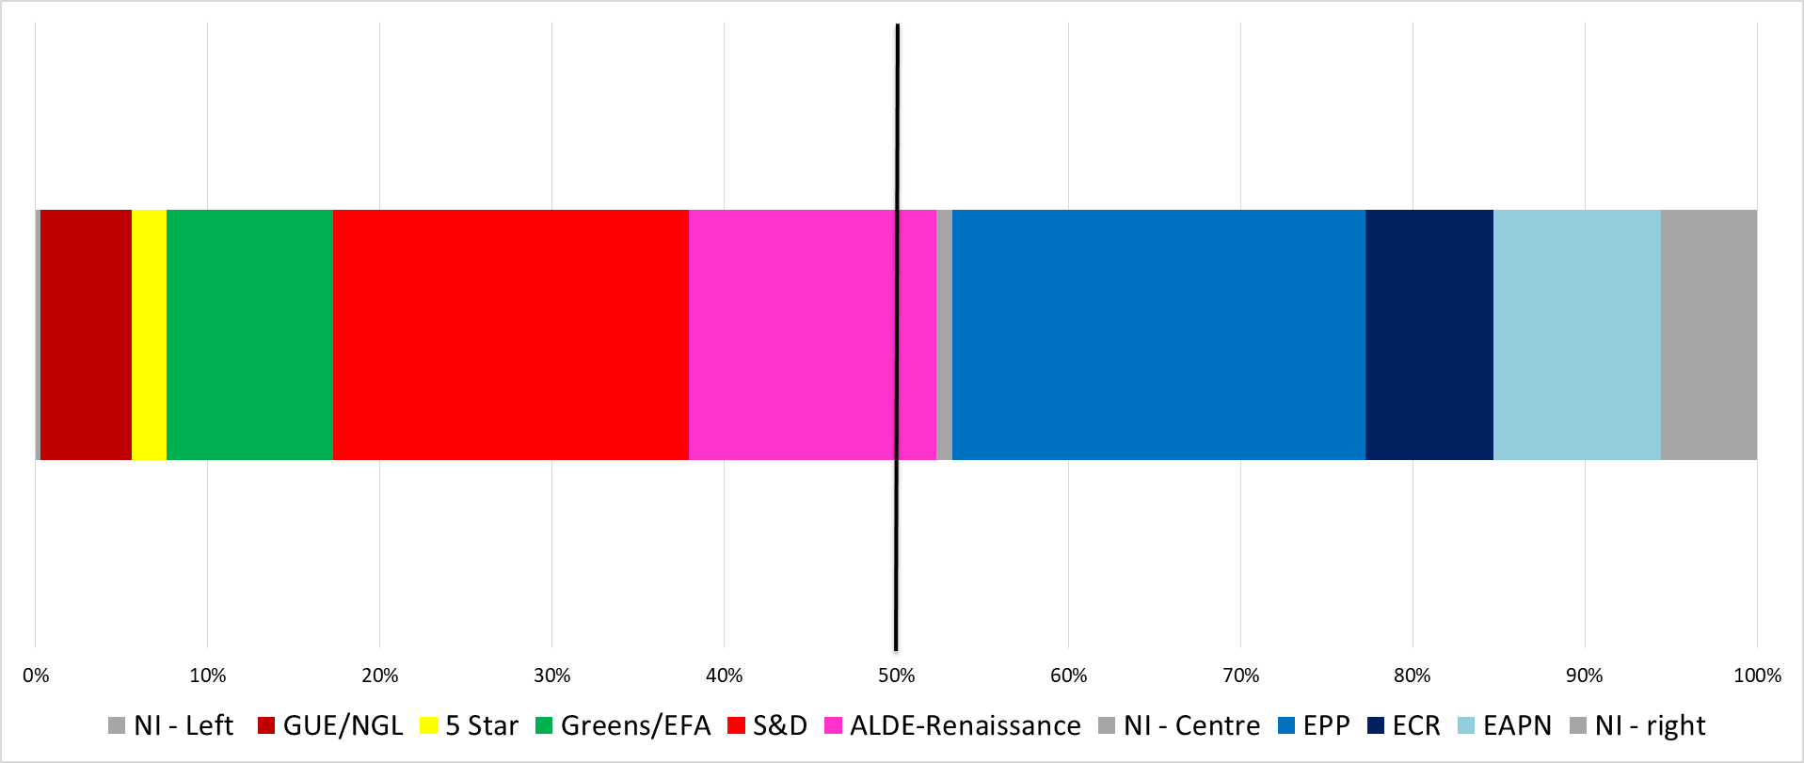
Political spectrum in the European Parliament after the EU elections

Slide 7
Coalition-building in the next European Parliament
Super grand coalition (S&D, ALDE-Macron, EPP): 60% of seats;
Super progressive coalition (GUE/NGL, 5 Star Movement, Greens/EFA, S&D, ALDE-Macron): 52% of seats;
Super conservative coalition (EPP, ECR, EAPN, Brexit Party): 47% of seats;
Centre-right coalition (ALDE/Macron, EPP, ECR): 46% of seats;
Grand-Coalition (EPP, S&D): 45% of seats;
Left coalition (GUE/NGL, 5 Star Movement, Greens/EFA, S&D): 38% of seats

Slide 8
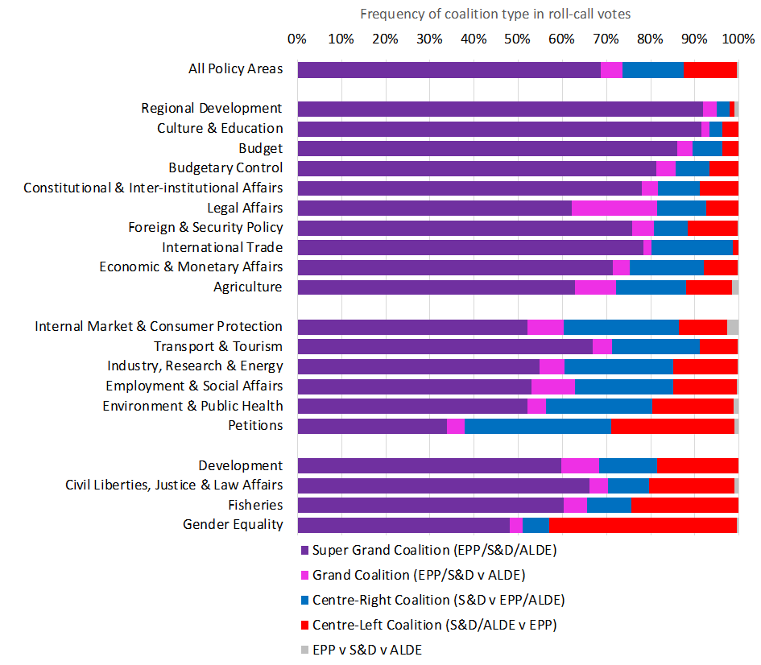

Slide 9
How to look at changes in the balance of power?

Slide 10
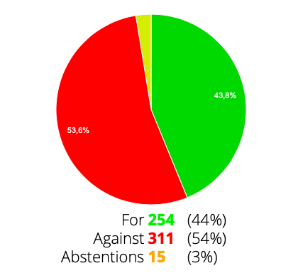
Support for introducing a common 5% Digital Services Tax on revenues

Slide 11
Support for the exclusion of agriculture and other sensitive areas of the scope of the TTIP

Slide 12
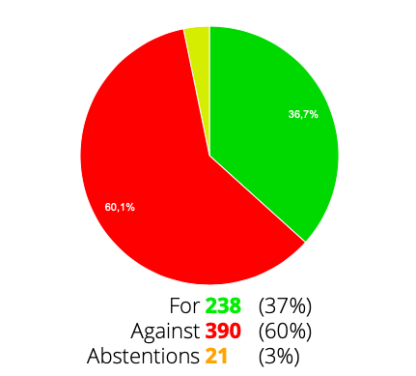
Support for a common minimum effective tax rate of at least 20%

Slide 13
ETS: Support for a higher linear reduction factor (2.4%)

Slide 14
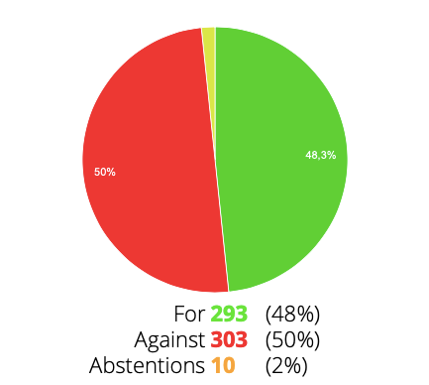
Softer rules on legal requirements to remove online terrorist content

Slide 15
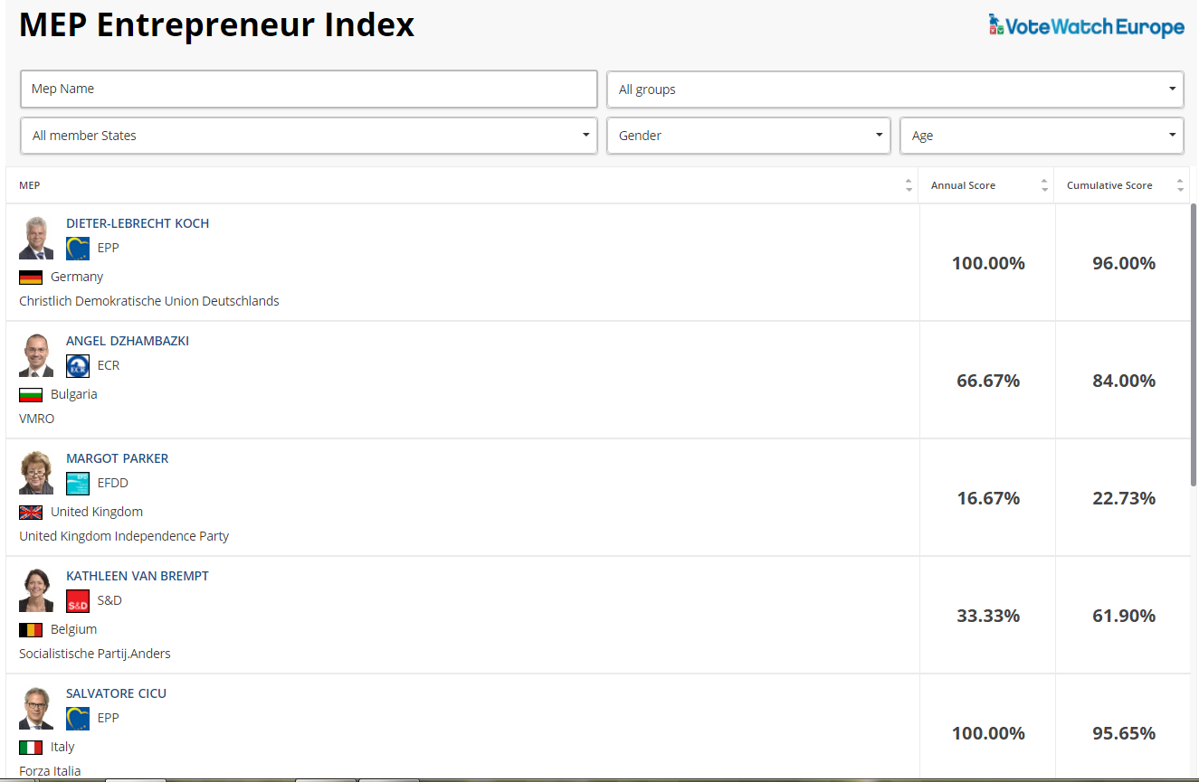

Slide 16
NB: about 60% of MEPs are new!
https://www.flickr.com/photos/83633410@N07/7658298768

Slide 17
Davide Ferrari
Research Executive, VoteWatch Europe
davide@votewatch.eu

