Slide 1
EU Policy Update call
PFAS Restriction Proposal
Thursday, 13 July 2023
Elena Maccaferri, AEU

Slide 2
What are Per- and poly-fluoroalkyl (PFAS) substances?
PFAS are a very broad class of thousands of synthetic chemicals that are used throughout society.
They have a wide range of different physical and chemical properties (and can be gases, liquids, or solid high-molecular-weight polymers).
PFAS are widely used as they have unique desirable properties e.g. they are stable under intense heat and can resist chemicals, but others are also surfactants and are used as water and grease repellents.
For these reasons, PFAS are used by a wide range of industry sectors: e.g. aerospace and defence, transportation, aviation, food contact materials, textiles, leather and apparel, construction and household products, electronics and semiconductors, firefighting, food processing, and medical articles and the processing industry.

Slide 3
EU PFAS restriction

Slide 4
What is REACH and a REACH restriction?
Registration, Evaluation, Authorisation and Restriction of Chemicals (REACH) is the European Union regulation dating from 18 December 2006, addressing the production and the use of chemical substances and their potential impacts on both human health and the environment
The regulation established the European Chemicals Agency (ECHA), which manages the technical, scientific and administrative aspects of REACH.
REACH restrictions limit, ban or set conditions on the manufacture, placing on the market (including imports) and use of a substance or group of substances
Restrictions are a measure for protecting human health and/or the environment from risks posed by chemicals on their own, in mixtures or in articles.

Slide 5
What is the EU PFAS REACH Restriction?
Since 2020, the competent authorities of five countries (Germany, Netherlands, Sweden, Norway, and Denmark) have prepared a REACH restriction dossier for all PFAS. A REACH restriction “is considered to be the most effective and efficient way to manage such a large and complex group of substances that are used in numerous applications”.
On 13 January 2023, the five countries submitted their proposal, which aims to restrict 10.000 PFAS substances, making it “one of the broadest restrictions in the EU’s history”.
The Dossier proposes a ban with a general transition period of 18 months and a few time-unlimited derogations and some use-specific time-limited derogations (6.5 or 13.5 years after entry into force).
Scope: PFAS are any substance that contains at least one fully fluorinated methyl (CF3) or methylene (CF2) carbon atom (without any H/Cl/Br/I attached to it); in line with the OECD definition (2021).
PFAS should not be manufactured, used or placed on the market as substances on their own and not be placed on the market in another substance, as a constituent, a mixture, an article.

Slide 6
EU | State of Play
January 2023: authorities from Denmark, Germany, the Netherlands, Norway and Sweden submitted PFAS restriction proposal to ECHA
Proposal intends to ban manufacturing, placing on market and use of all PFAS 18-months after restriction’s entry-into-force
PFAS definition according to OECD: around 10,000 substances
No differentiation according to properties and risk profiles in the proposal
Exemptions only for active ingredients in medicines, pesticides, and biocidal substances
Use-specific time limited derogations (6.5 or 13.5 years) proposed for small number of applications where currently no alternatives are available
Process:
Stakeholder consultation until September 25, 2023
~ March 2024: ECHA committees to send their opinions to European Commission
~ May – July 2024: European Commission to prepare draft amendment to the list of restrictions (Annex XVII): subsequently, scrutiny by Council and European Parliament
~ 2025: Entry-into-force

Slide 7
PFAS restriction calendar (2023-2026)
RAC adopts opinion and drafts SEAC opinion
Council/European Parliament voting (to be confirmed)
Presentation of the restriction dossier
Restriction adopted (to be confirmed)
Public consultation
ECHA Opinion
Consultation on SEAC's draft opinion
Draft Annex XVII
Publication (7 February)
Entry into force
Quality check
Conformity check
13 January 2023
22 March 2023-Sept 2023
Nov 2023
Nov 2023-Jan 2024
Feb-Mar 2024
Q1-Q3 2025 (tbc)
Q3 2025 (tbc)
Q4 2025
Beginning 2026 (tbc)
PREPARATORY PHASE
ECHA PHASE
COMMISSION PHASE
VOTING/ENTRY INTO FORCE PHASE
STAGE 1
Preparation of Annex XV
STAGE 2:
Public consultation
STAGE 3:
Development of the opinion
STAGE 4:
Commission Stage
STAGE 5:
Entry into force and implementation
“REACH Committee”
First bans foreseen as of July 2027

Slide 8
What would be the impact of the PFAS restriction on the industry?
The restriction would have a significant negative impact on a variety of different sectors. Today, we will present the impact on the following sectors:
Pharmaceutical
Medical technology
Energy
Electrical switchgear and grid expansion
Construction and Mining Equipment Manufacturer
Mobile air-con, heating and cooling, foams
The processing industry including chemical, pharmaceutical, food, and semiconductor producers

Slide 9
Pharmaceutical sector – Cindy Nam - Pfizer
Use Scenario | Impact to Pharma if No Exemption (based on OECD 2021 Definition)
PFAS APIs | PFAS APIs would not be manufactured in that Member State (MS). PFAS drug product (final medicinal product) could not be marketed in that MS.
PFAS Excipients | Drug product could not be marketed in that MS
PFAS Intermediates | PFAS APIs would not be manufactured in that MS
PFAS Reagents (TFA) | Peptide APIs would not be manufactured in that MS
Medical Devices | These products could not be manufactured or marketed in that MS
Primary Packaging (Elastomers) | These products could not be manufactured or marketed in that MS
Primary Packaging (Blisters) | These products could not be manufactured or marketed in that MS
Fixed and/or Consumable Equip. | APIs & Drug Products would not be manufactured in that MS
What the Pharma Sector might consider asking for in the Proposed PFAS Restriction?
A combination of exemptions and time unlimited/limited derogations until alternatives are (a) identified and (b) commercially available in the quantities required by our sector. “Without these exemptions and derogations, the proposal ‘will effectively stop all manufacturing in Europe’ within a few years” Lars Fruergaard Jørgensen, chief executive of Novo Nordisk, a Danish drugmaker, and Efpia president speaking to the FT 3rd July 2023

Slide 10
Pharmaceutical sector
The restriction would cause long-term unavailability of most human [and veterinary] medicines (incl. vaccines) for all therapeutic areas in Europe and beyond.
Substances such as fluoropolymers are indispensable in production lines, immediate/primary packaging and medical devices as they aid the manufacture and delivery of medicines to patients.
Alternatives are not immediately available, while substitution would require a completely new, expensive build-up of production equipment and lines, which could take years.

Slide 11
Medical Technology – Marc Theurer, Gore
No exemption for medical technology proposed: Restriction with significant impact on availability of medical technology in the EU
According to trade associations SPECTARIS, 30 – 50% of surgeries and treatment measures performed in German hospitals in 2021 with PFAS-relevant products
Only some time-limited derogations for some medical devices: Annex E, p. 334
Proposed transition periods (6,5 and 13,5 years) too short for medical devices
In many cases no substitution to high-performance substances such as fluoropolymers available or even foreseeable
Even in cases where an alternative is available: significantly more time needed to ensure transition in full compliance with legal and industry standards

Slide 12
Applications in Medical Technology
Diagnostic laboratory testing
Drug eluting stents
Vascular grafts and plugs
Medical device (MD) lubricants
Interventional cardiac occluders
Interventional endoprostheses
Surgical and pledgeted sutures
Ophthalmic products
Medical tapes
Cardiovascular patches
Tubes and catheters
Hernia meshes
Drug combination products
Sterile packaging applications
Components of stents, guidewires, catheters, and dilators
Cleaning solvents for MDs
Medical imaging devices
Analytical instruments
Patient monitoring equipment
Filters and vents (ex: ostomy bag)
Insulin pumps
Wire insulation in electronic MDs
Refrigerants in lab equipment
Coating of surgical instruments
And many more

Slide 13
Defense and aerospace – Wojtek Popielarz, Gore
A&D require combination of properties that can only be met by high-performance materials such as fluoropolymers
Alternatives of lower quality is not an option in A&D sector, and it is considered unlikely that feasible alternatives will be found in the foreseeable future.
A&D not discussed as separate sector in PFAS restriction proposal. Time-limited derogation of 13,5 years for transport safety-related applications
Other applications would no longer be available 18 months after EiF: significant negative impact on availability and supply
It is vital to consider future A&D requirements that cannot be achieved without PFAS (e.g. higher voltages, increased electrical current, faster data rates, and improved sealing enable miniaturization, weight reduction, and fuel efficiency in conventional and more electric aircrafts)

Slide 14
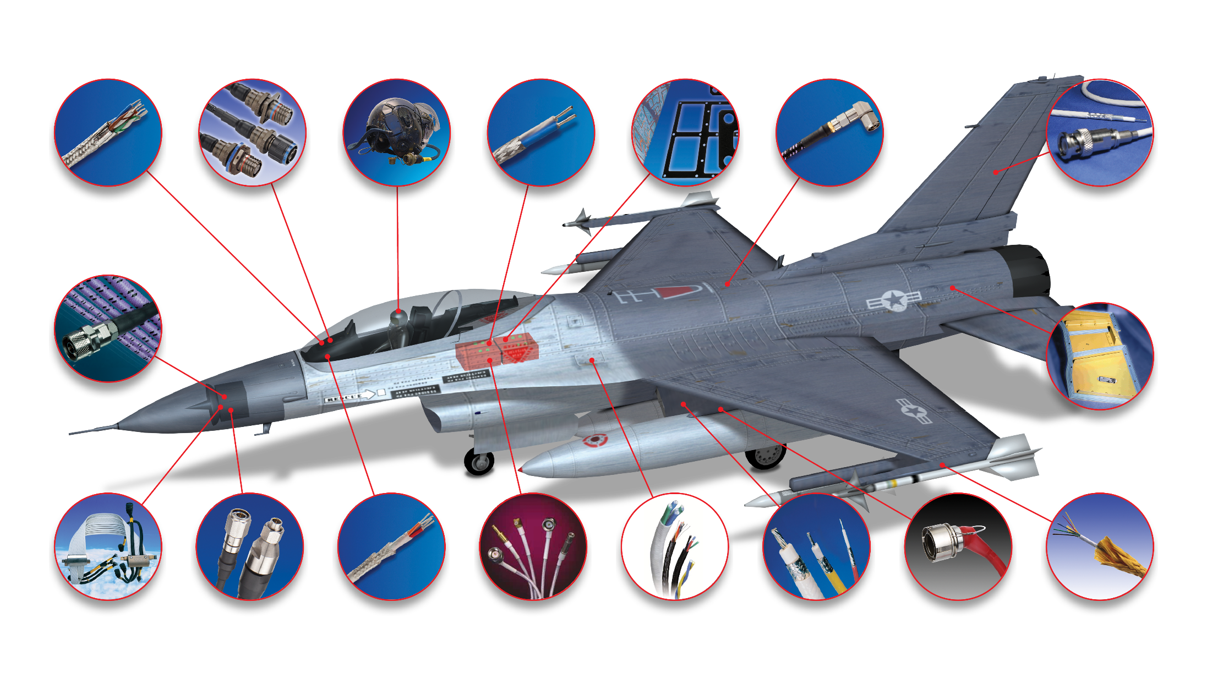
Applications in Aerospace |Example

Slide 15
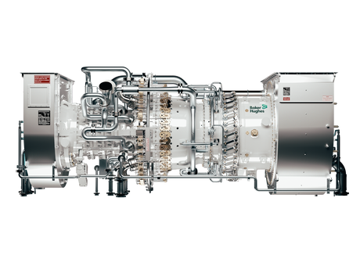
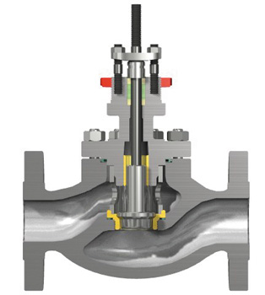
Energy sector – Antonio Clemente, Baker Hughes
Case Study: Why are Fluoropolymers (FPs) relevant for the Energy Sector?
Equipment where FPs are used
Turbines
Valves
Pumps
Sensors
Control Panels
LNG trains – security of gas supply
FP Sealing Devices Contribute to Safety and Environmental Protection.
“Harsh” Operating Conditions: High Temperature, High Pressure, Presence of Hazardous Fluids
Sealing Devices prevent gas or liquid leakages which could lead to safety-critical events and environmental damage
PTFE-sheathed cables enable longer sensor life and critical parameters monitoring failures
FP Relevance for Clean Technology
CO₂ Storage
H₂ Vaue Chain
Geothermal
Repairability / Replaceability of FP-Containing Equipment
Case study on Valves. Replacing a FP-containing valve with a PFAS-free valve would require the redesign of the installation (e.g. Power Generation Installation) due to larger valve size. Furthermore, a PFAS-free valve may not meet industry standards as fluid leaks would occur.

Slide 16
Applications in Clean Energy
Renewable Energy Production
Energy Storage
PFSA, FKM, PTFE
PTFE, FEP, ETFE, PFSA, FKM, PFPE
Ionomer exchange membranes for flow batteries
Gaskets and seals to prevent leaks and environmental releases to reduce carbon dioxide emissions into the atmosphere
Binder materials in the electrodes
Photovoltaic front sheets protection
Photovoltaic back sheets insulation
Junction boxes in photovoltaic vents
Control centers for offshore wind parks
Wind turbine paints and coatings
Release film: support production of composite turbine blades esp. for offshore turbine PTFE bearings
Stationary & Mobility Fuel Cells
Hydrogen Production
PFSA, FKM, PTFE
Ionomer exchange membranes for PEM fuel cells
Gaskets and seals to prevent leaks and environmental releases to reduce carbon dioxide emissions into the atmosphere
Binder materials in the electrodes
Component of the gas diffusion layers (GDLs)
PFSA, FKM, PTFE
Ionomer exchange membranes for PEM water electrolysers
Tubing fluid transfer in alkaline water electrolysis hydrogen production systems
Binder materials in the electrodes
Gaskets and seals to prevent leaks and environmental releases to reduce carbon dioxide emissions into the atmosphere

Slide 17
Electrical switchgear and grid expansion– Bertrand Portal, GE Verona
Current situation:
Fluorinated Gases (F-Gases) are used as insulating medium for high voltage equipment and for specific application for which no substitute exists nor is demonstrated to be feasible.
PFAS have unique properties that allow them to perform reliably in extreme high-pressure and high temperature environments (seals, O rings, gaskets, lubricants etc.).
PFAS insulating gases help to replace Sulphur hexafluoride (SF6), a GHG with a high global warming potential (24,300 times that of CO2). Their emissions are regulated by the EU F-Gas Regulation, currently under revision.
Impact on the sector:
Proposed time-limited restriction would lead to a sudden stop without proven market-ready, resource-efficient alternatives.
Independent research organizations (e.g., SINTEF) agree that ban on SF6-free alternatives with PFAS would undermine the greening of the grid, the rollout of renewable energy and ultimately the decarbonization of electrified sectors.
Only one technology to be allowed, produced by just one company: threat to competition and limited production capacity.
Use of SF6 to be potentially prolonged
PFAS also used in circuit-breaker. PTFE (a solid PFAS) nozzles is key to make the electrical arc quenching possible. Without the PTFE nozzle, no gas circuit breaker could be available, and the electricity grid could not be efficiently protected.

Slide 18
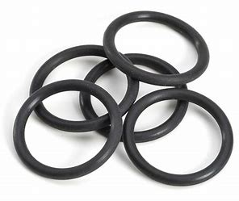
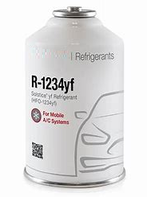
Construction and Mining Equipment Manufacturer Dr. Kellerbauer, Holger (Caterpillar)
KEY USE 1: Seals (mainly FKM & PTFE) for high-pressure and/or high temperature environment
FKM-based products are used within systems that produce up to 250°C and require strong chemical resistance, e.g., hydraulic systems, fuel lines, clutch disks, crank shafts. No PFAS-free alternative capable of performing at high temperatures and having the required chemical resistance for mobile machinery products is available.
PTFE-based products are used within systems with less stringent requirements and are probably replaceable with to-be-found alternatives - but re-design of thousands of seals will take a substantial effort.
Less durable seals translates into more frequent maintenance i.e., replacement, creating substantial amounts of waste, driving cost and potentially risking a higher occurrence of high-pressure leaks.
KEY USE 2: Refrigerants for cooling operator cabins and traction batteries (mainly R-134a & R-1234yf)
The non-road industry utilizes HFO & HFC refrigerants (containing PFAS) to satisfy various health, safety and ergonomic requirements to cool down operator stations and large batteries. These gases (especially R-1234yf) possess non-corrosive and non-toxic characteristics with a low global warming potential, zero ozone depleting potential and a low boiling point.
Refrigerants are properly controlled by the F-Gas Regulation (EU) 517/2014. All (readily) available alternative solutions are either banned, or present a high risk of flammability (ammonia, propane, and isobutane). CO2-based systems are being explored by the automotive industry, but it will probably take about 7 years for widespread availability.

Slide 19
Mobile air-con, heating and cooling, foams – William Parker, Honeywell
Given the broad definition of PFAS refrigerants such as fluorinated gases have been pulled into the scope of the restriction.
F-gases, such as HFOs, are registered under REACH with no concerns raised through their dossier – they are not so-called PBTs
The removal of f-gases from the market will have a serious impact on the transition to heat pumps and electric vehicles in Europe
Many of the alternatives do not have the same efficiency characteristics.
We also believe there is no scientific justification for their restriction.

Slide 20
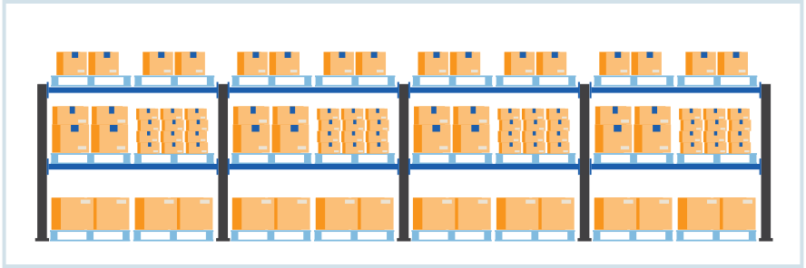
Applications in the Cold Chain
Foam
Air Conditioning & Refrigeration
HFCs, HFOs
HFCs, HFOs
Building Insulation and Insulation for Cold Transportation (Shipping Containers / Railcar / Trailers) and LNG terminals (Low-pressure spray foam)
Walk-in Cooler Panels
Reach-in Coolers
High-End Residential Refrigerators
High-End Commercial Refrigerators
Refrigerated Warehouse – SPF Insulation
Spa foam Insulation
Water heater foam insulation
Lining of valves, piping, tubing, filters, seals, gaskets and other standard fluid handling components
Lining of mixing vessels and tanks
Coating on processing belts
Refrigeration for food preservation (farm)
Industrial Ice Making (fishing vessels)
Refrigerated transport (truck/trailer)
Refrigerated transport (container – rail – ship)
Refrigeration for food processing (flash freezing, etc.) (Industry graphic bullet points excel)
Refrigerated Storage (warehouse) (Industry graphic bullet points excel)
Refrigeration at point of sale (grocery, C-store) (Industry graphic bullet points excel)
Refrigeration for food/beverage retail (restaurant, bar) (Industry graphic bullet points excel)
Commercial Ice Making (Industry graphic bullet points excel)
Refrigeration – home appliances (Industry graphic bullet points excel)

Slide 21
Chemical Producers / Processing Industries– Susanne Veith, DuPont
PFAS are used in a variety of applications to guarantee the safe operations of industrial sites (for examples see previous slide). Those substances are also critical to control and abate emissions.
The combined unique set of properties (e.g. durability, chemical resistance, temperature resistance, dielectric properties) make them indispensable for production applications in the processing industry (e.g. chemicals, food pharmaceutical, semiconductors).
The current proposal will have a significant impact on industrial sites. Time unlimited derogations for PFAS use in industrial settings will be needed to avoid a ban of critical PFAS uses in the production industry.

Slide 22
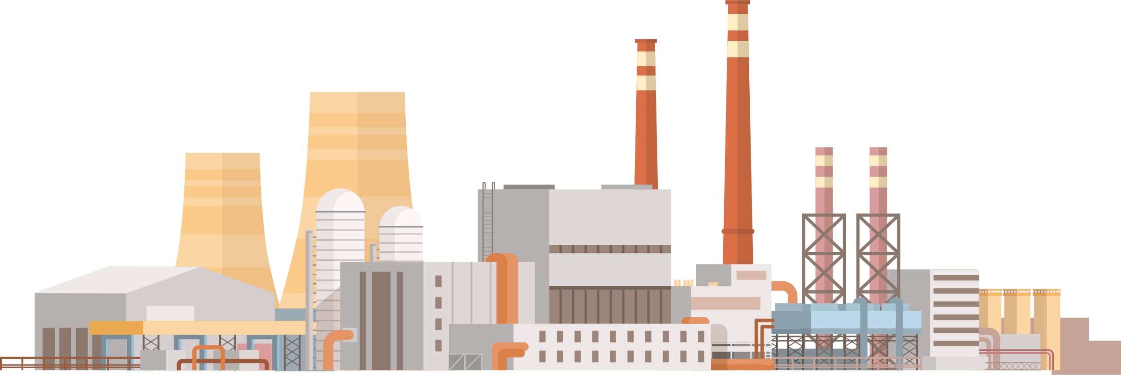
Applications in Chemical Production - – Susanne Veith, DuPont
1/2
Manufacturing and processing
Technical equipment
HFCs, HFOs
PTFE, FEP, PFA, ETFE, FKM, PFPE, PFSA, FFKM
Propellants in degreasers, leak detectors, sealants, paints, drain openers
Valves
Vessels
Reactor vessel and agitator lining
Lined/coated pipes, fittings, valves
PPE
Heat tracing
Seals / Gaskets
Pumps
Processing aids
Conveyors
Catalysts
Mold Release
Ion Exchange membranes
Instrumentation lining
Filters/Membranes (air/water treatment)
Refrigeration machines coolant
Bolts/washers
Cable & Wiring / Electronics / Power supply
Distillation column packaging
Lubricants
HFCs, HFOs, PTFE, FEP, PFA
Transport and distribution
Container lining
Packaging
AC cooling
Very low temperature refrigeration

Slide 23
Way forward – alternatives to a blanket ban exist
Fluoropolymers should get “no time-limited derogation” for manufacturing and use in applications in transportation, medical, electronics, semicon, hydrogen, communication, chemical and other industrial and professional applications.
Condition: responsible manufacturing through abatement & end-of-life management (manufacturers & downstream users).
Low Global Warming Potential F-Gasses should be derogated for industrial and professional sectors applications (Residential, Automotive, Blowing agents for insulation/low pressure spray foams).
Condition: Recovery of F-gasses during life, periodic leak-checks, recovery end of life.

Slide 24
Overview Legislative and regulatory iniatives on PFAS | Global

Slide 25
US | State of Play
Federal level
On June 22, 2023, U.S. Senators Tom Carper (D-Del.) and Shelley Moore Capito (R-W.Va.), Chair and Ranking Member of the Senate Environment and Public Works (EPW) Committee, released draft PFAS legislation for stakeholder comments:
PFAS definition: “a non-polymeric perfluoroalkyl or polyfluoroalkyl substance; and a side chain fluorinated polymer that is a member of a group of human-made chemicals that contain at least 2 fully fluorinated carbon atoms. The term ‘perfluoroalkyl or polyfluoroalkyl substance’ includes the degradants of a substance.” Importantly, the definition does not cover fluoropolymers.
Draft legislation would establish a deadline for regulators to set drinking water standards for certain PFAS, require a study on uses of PFAS in commerce, and require EPA to work with standards setting group, among other provisions. The draft legislation does not create new regulations or restrictions on the uses of PFAS.
In addition: Potential for PFAS provisions in “must pass” legislation (NDAA, Farm Bill) later this year
State level
Different approaches and priorities: Maine likely to amend its restrictive PFAS law next year; Minnesota recently enacted similar law, Several states enacting product-specific bans

Slide 26
UK | State of Play
April 4, 2023: UK Health and Safety Executive (the UK REACh “Competent authority”) released regulatory management option analysis (RMOA)
Initial approach on PFAS
Continued collaborative work across government and with external stakeholders to bring together work on PFAS strategically and further investigation work: political decision on next steps in QIII/2023.
RMOA embraces risk-based approach: No necessity to focus on low hazard groups such as fluoroplastics or fluoroelastomers
In addition, exemptions for other PFAS (as individual substances or groups) considered
Criteria for exemption:
evidence of low hazard or safe use
High socio-economic importance
No alternatives available
UK REACh Authorisation for processing aids in manufacturing/processing of fluorinated polymers

Slide 27
Japan | State of Play
Japan is considering how to move forward on PFAS
PFOA and PFOS banned in 2021
Ongoing procedure to ban PFHxS
Expert panels to discuss next steps on PFAS in Q3/2023: then government decision about potential next steps
METI (Japanese Ministry of Economy, Trade and Industry) and MHLW (Japanese Ministry of Health, Labour and Welfare of Japan) aligned on a position paper on the EU PFAS
METI and MHLW underline that not all PFASs have the same properties, uses, exposure and risks
Advocate for science-based approach to ensure that PFAS regulation is targeted and balanced: no ban on substances that have not posed an unacceptable risk
METI and MHLW warn that potential lack of risk identification may lead to the possibility of replacing PFASs with non-PFAS alternatives that pose a higher risk to human health and the environment
For substances for which alternative substances have not yet been identified, even a 12-year grace period may not be sufficient to confirm their availability
Unbalanced restriction would seriously impede international trade

