Slide 1
Brussels Briefing
Monday, 17 March 2025
amchameu.eu

Slide 2
Welcome
Malte Lohan
CEO, AmCham EU

Slide 4
This is the title of your slide
Monday, 17 March
12.30 – 13.45 Europe through a US business lens: opportunities and challenges
13.45 – 14.00 Group photo and transfer to Mona Lisa room
14.00 – 15.15 Testing times for transatlantic relations: towards an action plan
15.15 – 16.00 EU legislative outlook: trends and focus for the upcoming cycle
16.00 – 16.15 Coffee break
16.15 – 17.30 Turning Insights into Action: the roadmap for competitiveness and simplification
19.00 – 21.00 AmChams dinner and quiz
This is your content

Slide 5
Tuesday, 18 March
9.15 – 10.00 A Clean Industrial Deal to boost competitiveness and sustainability in the EU
10.00 – 10.15 Coffee break
10.15 – 11.00 Simplifying Digital Policy for Competitiveness and Resilience
11.00 – 11.30 Coffee break and group photo
11.30 – 12.30 Debriefing with the AmChams Presidents (one representative per AmCham)
12.30 – 13.30 Transatlantic Conference – welcome networking lunch
13.30 – 18.30 Transatlantic Conference and reception (if registered)
19.00 – 21.30 Transatlantic Dinner (if registered)
This is your content

Slide 6
Collaboration
Annual Brussels Briefing​
EU Policy coordination calls for AmChams ​
Position papers distribution/opportunity to endorse our position/co-sign our letters​
Delegations to the EU Member States:​
EU Council Presidency delegations​
Delegations to EU agencies​
Other ad-hoc delegations​
Active contribution to the ACE Best Practices Groups​
Ad-hoc joint Committee calls​
Events collaborations and sponsorship / co-branding opportunities (eg.Transatlantic Economy Report)​
This is your content

Slide 7
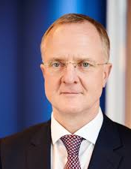
Europe through a US business lens: opportunities and challenges
Liam Benham
President, EU, NATO and Government Affairs Europe, The Boeing Company (Chair, AmCham EU)
Aylin Lusi
Vice President of Corporate Affairs, EMEAI, UPS (Board Member, AmCham EU)
Malte Lohan
CEO, AmCham EU

Slide 8
This is your content
Group photo and transfer to the Mona Lisa room!
(Next session starting at 14.00)

Slide 9
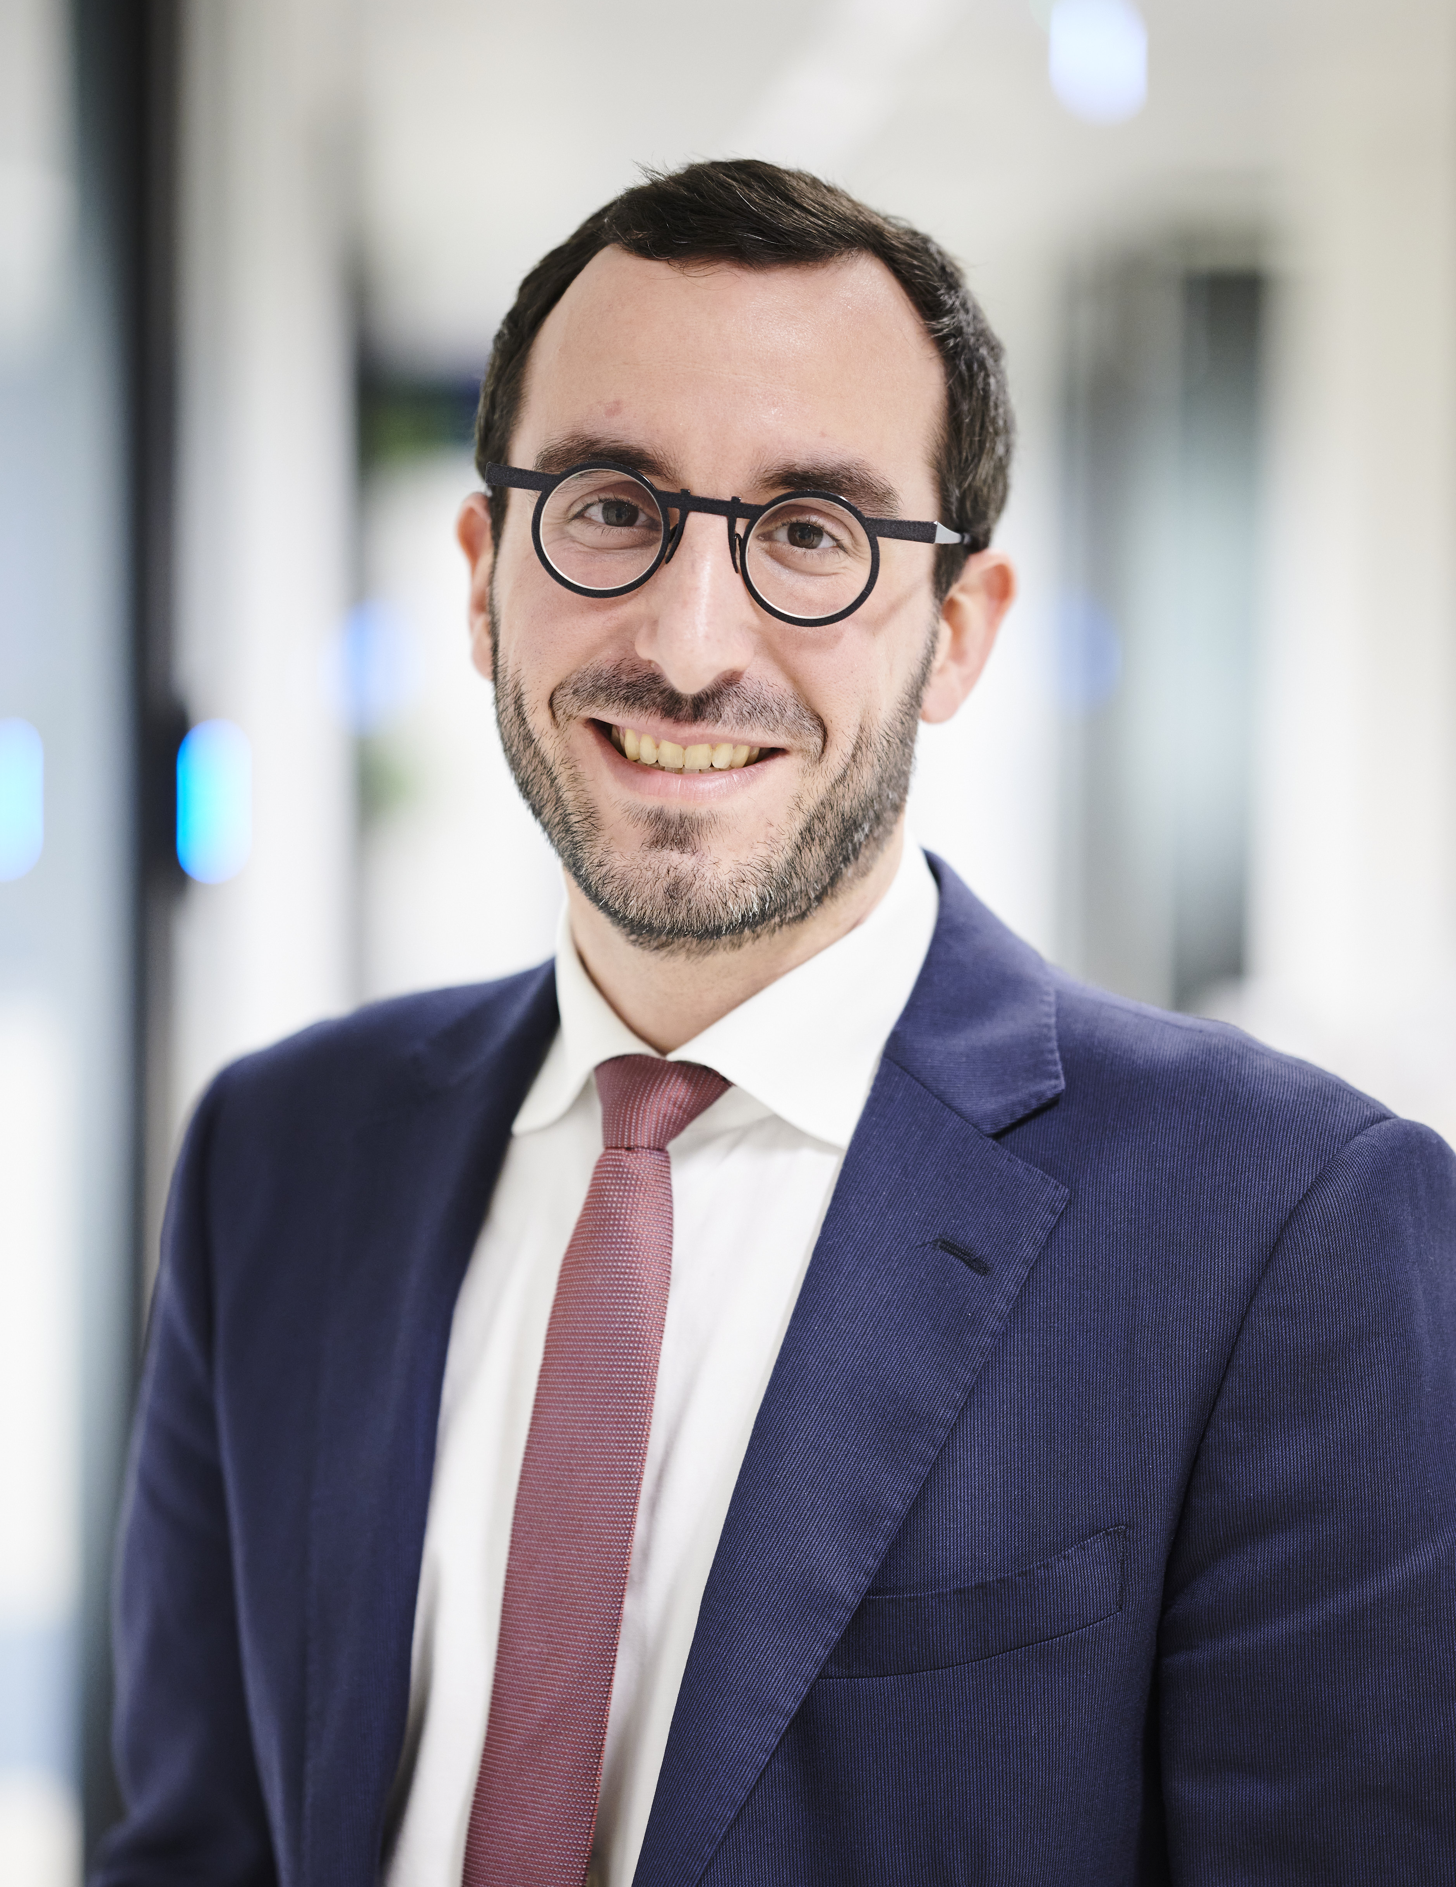
Testing times for transatlantic relations:
towards an action plan
Ajša Vodnik
Chair, AmChams in Europe and CEO, AmCham Slovenia
Thibaut L’Ortye
Senior Director of Public Affairs, AmCham EU

Slide 10
Today’s objectives

Slide 11
On the agenda
Context, approach and strategy
01
Tools and messaging
02
Perspectives from the network
03
Towards an action plan
04

Slide 12
On the agenda
Context, approach and strategy
01
Tools and messaging
02
Perspectives from the network
03
Towards an action plan
04

Slide 13
Our approach: a balancing act
Strike the balance between:
Defending our member companies’ business interests
Safeguarding our credibility with our EU stakeholders by setting the record straight and providing consistent messaging
Protecting our ability to engage with the US administration and build bridges across the Atlantic
Sticking to our longstanding principles (open trade, rule of law, human dignity, etc.)
Approach to political engagement
Trusted policy partner
Non partisan
Transparent
Principles-based
EU integration and Single Market
Economic growth
Open trade
Rule of law and stability
Human dignity

Slide 15
Milestones
Inauguration Day (20 January)
100 days (30 April)
...
...
Steel and alum tariffs
(12 March)
Transatlantic Conference (18 March)
Reciprocal tariffs (2 April)
Short-term action plan
Integrated strategy

Slide 16
Integrated strategy
Advocacy and content
Messaging on key issues
Position: an affirmative transatlantic policy agenda
Communications
Review of communications materials
Open approach to public engagements and media
Use of senior business executive voice
Engagement and outreach
Mapping of US government stakeholders
Congratulations letters
Outreach (virtual, Doorknock, other)
US Mission to the EU engagement
Research
Transatlantic Economy report 2025: streamlined
Data points and examples collection
Alliances
Alignment with US Chamber
Cooperation with European AmChams
Alignment with European trade groups

Slide 17
On the agenda
Context, approach and strategy
01
Tools and messaging
02
Perspectives from the network
03
Towards an action plan
04

Slide 18
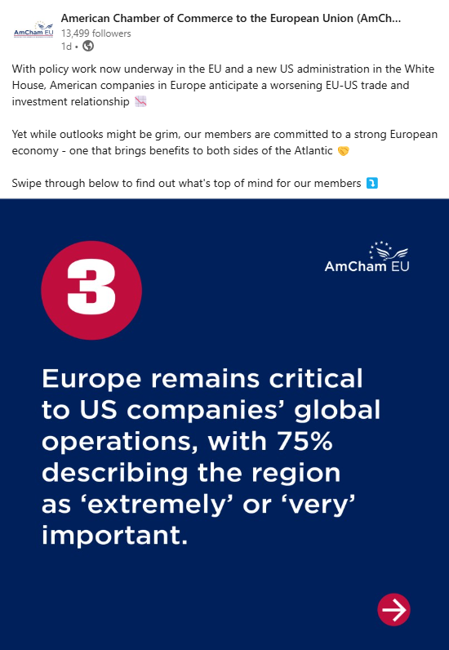
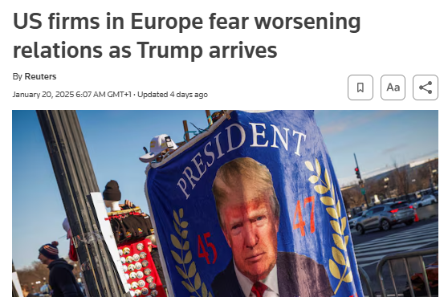
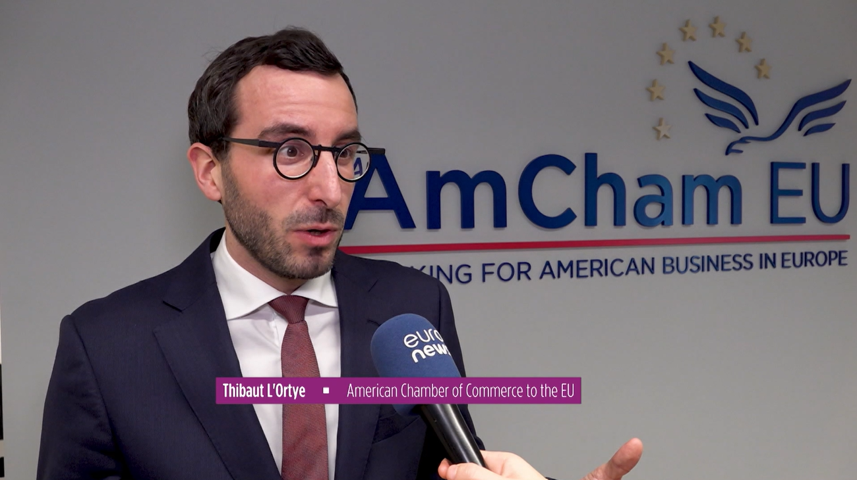
The tools that reflect the ‘balancing act’
Member survey (Inauguration Day)
Public statements
Risk of EU-US trade tit-for-tat
Steel and aluminium tariffs
Continued support for Ukraine
Transatlantic Economy report
Specific and local data
Messaging
Access enabler
Media briefing
European Parliament US Delegation
Trade attachés
Renew Group
Proactive and reactive messages
Social media
Open approach to media and external engagements

Slide 19
Messaging building blocks
We oppose tariffs – increase prices and disrupt supply chains
We are concerned about protectionist trends in Europe (public procurement, energy, defence, cloud, etc.)
The EU and the US must respect each other’s regulatory autonomy
American companies are committed to Europe
American companies are not treated unfairly in the Single Market
We must avoid a negative spiral of tit-for-tat – the EU and the US must strike a deal
With nuanced and pragmatic approach to tone and appropriate channel

Slide 20
On the agenda
Context, approach and strategy
01
Tools and messaging
02
Perspectives from the network
03
Towards an action plan
04

Slide 21
Testing times for transatlantic relations:
towards an action plan
Ajša Vodnik
Chair, AmChams in Europe and CEO, AmCham Slovenia
Thibaut L’Ortye
Senior Director of Public Affairs, AmCham EU

Slide 22
The results of the Slido survey are available here

Slide 23
On the agenda
Context, approach and strategy
01
Tools and messaging
02
Perspectives from the network
03
Towards an action plan
04

Slide 24
Pick one of the three questions to discuss
Access – How can we prepare for the potential reluctance of stakeholders to engage with US business interest representatives and what does our engagement strategy look like in the future?
Reputation – With anti-EU rhetoric coming from the US Administration, what are new ways/tactics to demonstrate our commitment to Europe?
Messaging – What are the messages on transatlantic issues that currently resonate best with your stakeholders? How can we strike the right tone to keep our credibility?
Choose one group member to report back one top idea/thought

Slide 25
We all have a role to play

Slide 26
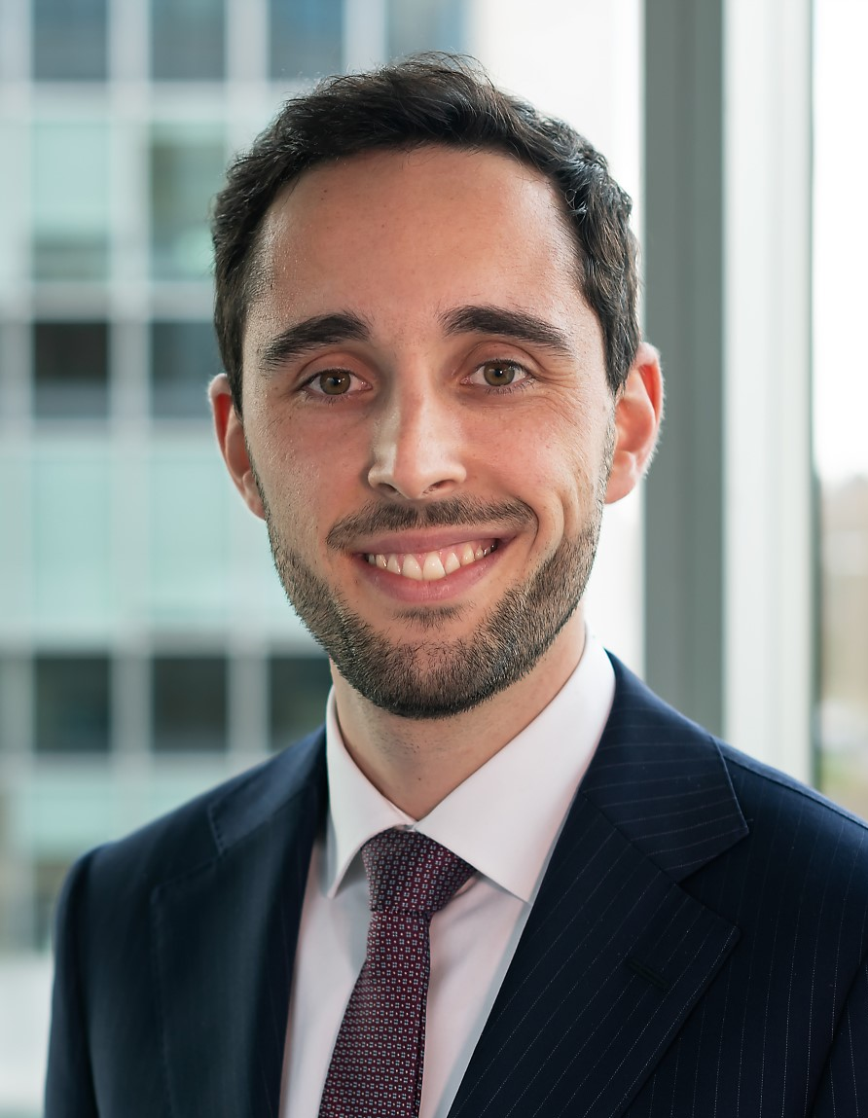
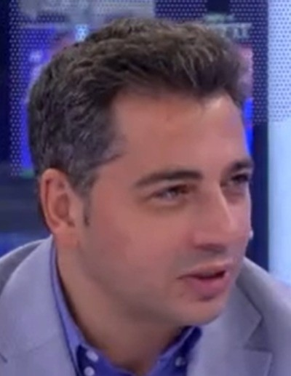
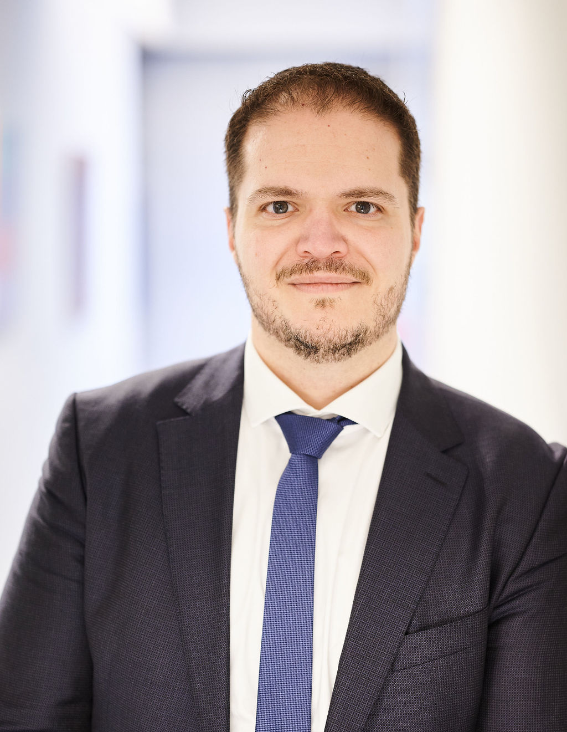
EU legislative outlook: trends and focus for the upcoming cycle
Andrea Chiarello
Director, Head of EU Government Affairs, Pfizer (Chair of the Policy Group, AmCham EU)
Doru Frantescu
CEO and Founder, EU Matrix
Marta Pawlak
Legal and Public Policy Director, AmCham Poland
Roger Coelho
Senior Policy Director, AmCham EU

Slide 27
This is your content
Coffee break!
(Next session starting at 16.15)

Slide 28
Turning Insights into Action:
The roadmap for competitiveness and simplification
Kim Watts
Senior Policy Manager, AmCham EU

Slide 29
Goal of today’s session
Discuss the state of play on the EU’s Sustainability Omnibus
Gather your insights about perspectives on regulatory simplification in your country
Brainstorm ways we can support each other and our memberships on simplification

Slide 30
Turning Insights in to Action
What’s a Competitiveness Compass and What’s an Omnibus?

Slide 31
What is the EU’s Competitiveness Compass?
Not a new policy announcement – but a way of COM communicating that it will be taking competitiveness & Draghi report seriously
Three core areas for action: innovation, decarbonisation and security

Slide 32
What is the Omnibus Package?
November ‘24 – von der Leyen indicated that certain existing & future ESG reporting obligations would be consolidated into an “omnibus regulation”
Specific focus on reducing “often overlapping” reporting in CSRD, CS3D & EU Taxonomy to be combined in effort to “reduce bureaucracy”
February ‘25 – COM work programme confirmed there would be a “fleet of Omnibuses” across many policy areas
Sustainability Omnibus Simplification Package published 26/2 – includes CSRD, CS3D, Taxonomy & CBAM

Slide 33
What’s in Omnibus?
2 legislative proposals – delay proposal and substantive proposals
Files in scope – CSRD, CS3D, Taxonomy, CBAM
Goal: reduce complexity for all businesses, especially SMEs & small mid-caps while staying on track for sustainability goals

Slide 34
Omnibus: Political State of Play
Strong support at high political level for Omnibus & opportunity for simplification – a unique moment
“The destination is the same, but we need to simplify how we get there”.
Heavy lobbying in Brussels from both sides but industry voices generally aligned on urgent need to tackle regulatory burden
Risks:
Severe political disarray, particularly within European Parliament
Turbulent transatlantic political climate, conflict with DC positions of members
Notes:
US Chamber letter in December - https://www.uschamber.com/finance/u-s-chamber-of-commerce-coalition-letter-to-congress-voicing-concerns-over-eu-corporate-sustainability-due-diligence-directive

Slide 35
AmCham EU Advocacy Activities
Advocacy supporting delay proposal – outreach, joint statement with other associations
Advocacy on substance
Cautious support on amendments already included, determining further suggested revisions in line with existing priorities
Strong support for current CBAM proposal
Facilitating dialogue on simplification affecting global businesses, including extraterritoriality
Thought leadership on Omnibus at key events

Slide 36
Turning Insights into Action
Workshop Session

Slide 37
Workshop: ACE Perspectives on Omnibus
How is the Sustainability Omnibus & simplification of EU law perceived in your country?
What feedback have you received from your member companies?
What are the barriers in your country to achieving regulatory simplification of EU law?
The Slido results are available here

Slide 38
Turning Insights into Action
Closing thoughts

Slide 39
There’s a fleet of Omnibuses coming….

Slide 40
… in a range of policy areas ….

Slide 41
… but it’s also about the road ahead – will there be a competitive focus on better regulation?

Slide 42
This is your content
Thank you!
See you at Basils Liberté at 19.00

Slide 43
This is your content
Welcome
The session will start at 9.15!

Slide 44
Brussels Briefing
Tuesday, 18 March 2024
amchameu.eu

Slide 45
This is the title of your slide
Programme
9.15 – 10.00 A Clean Industrial Deal to boost competitiveness and sustainability in the EU
10.00 – 10.15 Coffee break
10.15 – 11.00 Simplifying Digital Policy for Competitiveness and Resilience
11.00 – 11.30 Coffee break and group photo
11.30 – 12.30 Debriefing with the AmChams Presidents (one representative per AmCham)
12.30 – 13.30 Transatlantic Conference – welcome networking lunch
13.30 – 18.30 Transatlantic Conference and reception (if registered)
19.00 – 21.30 Transatlantic Dinner (if registered)
This is your content

Slide 46
A Clean Industrial Deal to boost competitiveness
and sustainability in the EU
Antonella Sopranzetti
Chair, Transport, Energy and Climate Committee, AmCham EU (ExxonMobil)
Anastasia Lajri
Senior Policy Adviser, AmCham EU

Slide 47
Overview
Transport, Energy and Climate committee 2025
The AmCham EU sustainability priorities 2025
Clean Industrial Deal
Advocacy on sustainability policy – in Brussels and beyond
Q&A

Slide 48
The AmCham EU Transport, Energy and Climate Committee
Industrial Clean policy: Open markets and low-carbon innovation
Climate: Safeguarding EU competitiveness while moving towards climate neutrality
Transport: Balanced, technology-neutral approach to low-emission mobility
Energy: Liberalised, secure, sustainable and technology-neutral energy market

Slide 49
2025 AmCham EU Sustainability Priorities
Sustainable Transport Investment Plan
Road transportation
Aviation
Clean Industrial Deal
Critical Raw Material
Industrial Decarbonisation Accelerator Act
Industrial Decarbonisation Bank
Energy security
Low carbon energy:
Nuclear
Hydrogen
Carbon Capture and Storage
Circular economy Act
Water resilience
CBAM
2040 climate targets
EU chemical industry package (REACH & Pfas etc)

Slide 50
Clean Industrial Deal pillars
Access to affordable energy (Action Plan)
Lead markets for clean supply and demand
Public and private investment
Secure access to materials and resources
Global markets and partnerships
Jobs and skills

Slide 51
CID : AEU recommendations
Ensure that the all CID policy initiatives promote an investment-friendly environment without protectionist measures, allowing contributions from all trusted partners.
Streamline and expedite permitting processes across EU jurisdictions.
Prioritize Regulatory Simplification
Streamline Legislation: Focus on reducing unnecessary administrative burdens and harmonizing regulations across member states to facilitate easier compliance.
Focus on energy prices
Adopt a technology-neutral approach to all new legislative framework under the CID to foster innovation and scalability across all EU policies.
Strengthen transatlantic relations
Collaborative Initiatives: Enhance cooperation with the US and other partners in areas like technology, energy, and sustainability to drive mutual benefits.
Foster an open and competitive market
European Competitiveness Fund which:
supports Public-Private Partnerships and de-risks private sector investments;
is aligned with WTO rules
is technology-neutral;
is non-discriminatory;
Enhance regulatory consistency across Member States to reduce fragmentation and compliance costs.
Strengthen alignment between new and existing regulations under the CID, including NZIA, Horizon Europe and Fit for 55, and align new EU regulations with global standards to create a level playing field for businesses.
Incorporate financial incentives and a technology-neutral approach into the Industrial Decarbonisation Accelerator Act to maintain competitiveness and flexibility.
Strengthen cooperation on and facilitate mutual recognition of certification and technology standards.
Forge international partnerships and work with international agencies to share best practices in clean technology and climate innovation

Slide 52
Impact on EU Member States: Why flexibility and inclusiveness in the CID matter -
Diverse energy landscapes across the EU:
Member states have different starting points and resources for decarbonization. For instance:
France relies heavily on nuclear energy.
Spain is advancing in solar and wind.
Poland is still transitioning from coal.
A non-discriminatory approach—recognizing all low-carbon energy technologies—ensures that each member state can adopt the energy mix that suits its infrastructure, geography, and economy.
CID as a blueprint for the 2040 Climate Targets:
The CID is expected to shape EU industrial and energy policy towards the 2040 climate targets, which will define the trajectory of decarbonisation policies for the next 15 years.
If the CID is too prescriptive or limits support to specific technologies, it risks excluding solutions that may be more effective for certain countries, and slow down the transition for countries that are still developing infrastructure for newer energy sources.
Why this matters: Flexibility ensures that no country is left behind and allows for tailored decarbonization pathways that can realistically meet EU-wide goals.
Flexibility and low energy prices
Allowing countries to deploy cost-effective, locally available technologies will lower the cost of transition and reduce energy prices in the long term. For example, forcing an expensive, non-local solution could drive up prices and slow decarbonization.
A flexible framework empowers member states to adopt solutions that stabilize energy prices and enhance energy security.

Slide 53
Impact on EU Member States: Financing the EU’s decarbonization
Public procurement changes
Incorporation of sustainability criteria:
Encourage the CID to ensure procurement frameworks are inclusive and open to trusted international partners in their definition of ‘European preference’ avoiding discriminatory practices.
State aid rules
The CID introduces revised state aid rules to accelerate decarbonization by supporting investments in clean technologies, energy efficiency, and sustainable production processes.
The state aid process, while streamlined, still requires detailed justifications and approvals that may delay urgent projects.
Why this matters: Member states should have the freedom to design aid schemes that reflect their unique industrial landscapes and decarbonization needs.
The CID will encourage revising public procurement rules to integrate European preference, sustainability, resilience, and low-carbon standards.
MS procurement frameworks will need to prioritize European-sourced goods and services that contribute to the EU’s climate objectives.
Risks reducing competition by limiting access for trusted international partners, including US companies, increase costs, delay innovation, and slow down the deployment of critical technologies that are not yet produced at scale in Europe.
Countries with less administrative capacity or expertise could struggle to navigate the process effectively, creating delays, uncertainty and fragmentation, affecting competitiveness of the Single market.
If state aid frameworks favor certain technologies over others, it could undermine flexibility and discourage diverse and country specific approaches to decrabonisation.
Advocate for non-discriminatory state aid rules that recognize all viable low-carbon technologies, including nuclear, hydrogen, carbon capture, and renewables, ensuring each country can choose the most viable and cost-effective pathway to meet climate targets.

Slide 54
Clean Industrial Deal pillars
First list of Strategic Projects under the Critical Raw Materials Act
CBAM review on the feasibility of extending the CBAM scope to other EU ETS + downstream sectors
Industrial Decarbonisation Accelerator Act
CID State Aid framework
Sustainable Transport Investment Plan
Recommendation on energy taxation
CBAM simplification
Extension of the Gas Storage Regulation
2025
Q1
Q2
Q3
Q4
Delegated act on low carbon hydrogen
Launch negotiations for the first Clean Trade and Investment Partnership
Recommendation to Member States to adopt tax incentives to support the CID
Trans-mediterranean Energy and Clean tech cooperation initiative
TechEU investment programme on scale-ups with the EIB Group and private sector
Revision of Public Procurement Directives for non-price criteria
TBC Legislative proposal on greening corporate fleets
European Grid Package
Green VAT initiative
2026
Q1
Q2
Q3
Q4
Legislative proposal on an extension of CBAM
Guidelines on Foreign Subsidies Regulation
Industrial Decarbonisation Bank
Circular Economy Act
EU CRM Centre for joint purchases and management of strategic stockpiles

Slide 55
Opportunities vs concerns
Opportunities
Stable investment environment
Support for capital-intensive projects
Reducing administrative burdens
Consistency across Member States
Affordable Energy Initiatives
Concerns
Potential market restrictions with European Preference principle
Impact on Investment
Risk of overlapping regulations
Implementation in the Member States
US stakeholder engagement

Slide 56
Advocacy at national and EU level
Council working groups negotiations
Council Position
Proposal sent to
Council of the EU
Trialogues aka negotiations between the Commission, the Council and the Parliament to reach an interinstitutional compromise
Legislative package
European
Commission
2024-2029
Consultation
European Parliament
Position
Proposal sent to
EP Committee negotiations
European Parliament

Slide 57
This is your content
Coffee break!
The next session will start at 10.15!

Slide 58
Simplifying Digital Policy for Competitiveness and Resilience
Diane Mievis
Head of EU Telecoms, Sustainability & Trade Policy, Cisco (Vice-Chair of the Digital Economy Committee, AmCham EU)
Kim Watts
Senior Policy Manager, AmCham EU

Slide 59
This is your content
Coffee break and group photo!
The debriefing with the Presidents will start at 11.30!

Slide 60
This is your content
Debriefing with the AmChams Presidents and Executive Directors

Slide 61
This is your content
Thank you!
See you on the 1st floor for the Transatlantic networking lunch

